Slide 1

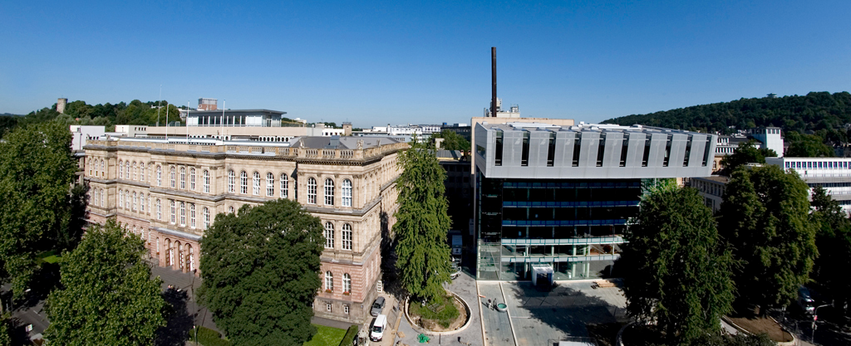
AixSense Team
SensUs 2018
Supervisor: Dr. Sven Ingebrandt

Slide 2
Outline
Initial research and Literature review
Concept Planning
Prototyping Requirements & Challenges
2 von 20

Slide 3
Introduction
Weekly meetings with Experts and supervisor to follow-up on the development
Discussing the necessary steps and possible challenges in designing a micro-sensor
Training and learning to use the various laboratories and software to develop and build our sensor
2 von 20

Slide 4
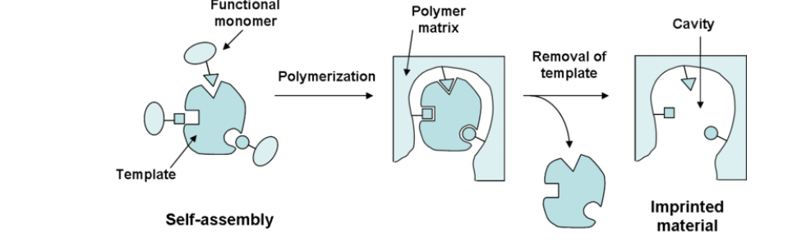
Research & literature Review
Literature review for methods of target molecule measurement
Molecularly Imprinted Polymers, MIPS vs. antibodies
Pros and cons
Basis of comparison
Measuring sensitivity, measuring time, reliability and reproducibility
MIPS selected as the method of measurement

Slide 5
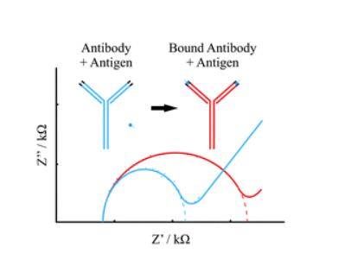
Research & literature Review
Literature review for methods of electromechanical signal measurement
Impedance Spectroscopy as the method of signal acquisition
Sweep at frequency range with a known potential or current
Calculating and plotting the impedance
Why spectroscopy?
Distinguish between multiple electrochemical reactions
Provide information about the capacitive changes in the system
Changes related to the reaction of target molecule at the surface of the microsensor

Slide 6
Concept Planning
Met with experts in the fields of biosensors to discuss the feasibility of different ideas
Experts in Microfluidics, biosensors, micro sensor design
Experts provided us with insight into what is necessary to build various sensor components
Sensor structure, functionality was discussed during previous meetings and a prototype of the sensor design is being developed

Slide 7
Design Breakdown
Sensor based on an array of 5 inter digitated electrodes, IDE
These electrodes will be covered by the sensing area, which contains of MIPS
There will be two fluidics channels which guide the target molecule to the sensing area
Sensor is encapsulated in a protective layer to avoid performance degradation
(Someone please as the hand drawn pictures we had somewhere :D)

Slide 8
Future Tasks
Tasks currently in team Agenda
Timetable to design a sensor on software and
Identifying the parts which are needed to be ordered
Please complete this also (:D)

